Slide 1
“Owning a home used to be the American Dream. Now it’s the American nightmare.”
-Foreclosed homeowner,
Boston Community Capital focus group, 2008
"No part of the financial crisis has received so much attention, with so little to show for it, as the tidal wave of home foreclosures sweeping over America. Government programs have been ineffectual, and private efforts not much better."
-The Economist, 2/19/2009

Slide 2
Boston Community Capital
25 year track record of investing in low-income communities
Over $500 million invested to date to create:
9,500 units of affordable housing
Child care facilities and schools serving over 5,000 children
750,000 square feet of inner-city commercial real estate
1,300 jobs in low-income communities
Investors include Bank of America, Calvert Social Funds, Harvard University, John D. and Catherine T. MacArthur Foundation, Rockefeller Foundation, Boston Foundation, Barr Foundation, Jewish Funds for Justice, and over 200 individuals
Historic loan losses of less than 1/30 of one percent
All investors have been repaid on time and in full

Slide 3
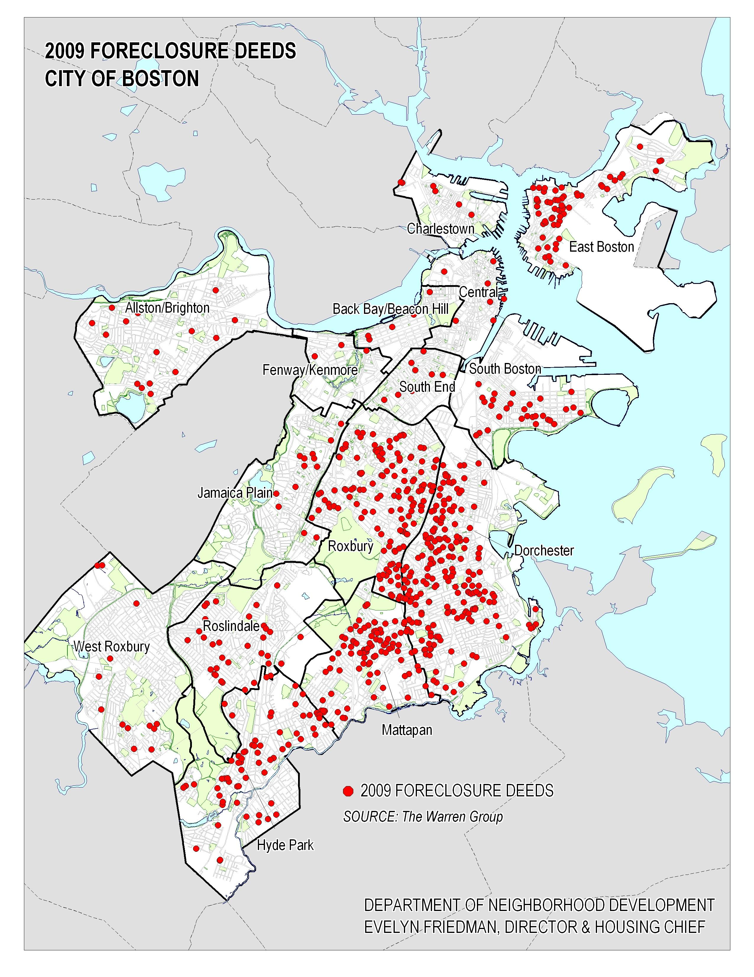
The Foreclosure Crisis
In Greater Boston alone, foreclosure petitions were up from fewer than 700 in the year 2000 to more than 15,000 in 2009.
Low-income communities are disproportionately hard hit
Six low-income Boston neighborhoods accounted for 83% of total foreclosures in Boston
Between January 2007 and December 2009, property values in these neighborhoods have dropped by more than 50%.

Slide 4
The Ripple Effect
City:
Loss of public investment, reduced real estate tax collection, and increased need for social services, police and fire protection
Neighborhood:
Falling property values, increased crime
Family:
Displacement,
damaged credit

Slide 5
Understand the Challenge
Reviewed 700 title histories of foreclosed properties
Focus groups with foreclosed homeowners in Boston, Fall River, and New Bedford
Individual conversations with homeowners, advocacy organizations and community groups
Routes to foreclosure
Multiple refinances add costs and fees
First-time homeowners unable to afford monthly payment after “teaser” rate expired
Bad underwriting: homeowners approved for loans they could not afford
Short-term personal or family crisis (e.g. car accident or spouse’s illness) compromised ability to keep payments current

Slide 6
Stabilizing Urban Neighborhoods (SUN) Initiative
Use the decline in real estate prices in low-income neighborhoods to purchase foreclosed properties at a steep discount
Resell and provide financing to existing occupants (provided they have evidence of hardship) at affordable prices, consistent with historical underwriting criteria
Meet the needs of low-income borrowers through modified mortgage instruments
Avoid moral hazard by shared appreciation second mortgage
The only program in Massachusetts focused on keeping residents in place

Slide 7
Who Does SUN Serve
Low-income individuals and families in Boston and Revere who are facing eviction due to foreclosure.
Targeted geography: Focused on low-income neighborhoods characterized by high rates of foreclosure and sharply declining property values.
Economic or personal hardship: Facing eviction due to hardship and/or predatory loan
Stable income: Able to afford fixed rate non-predatory mortgage based on current market values for real estate in the neighborhoods

Slide 8
Meet Borrower Needs
Fixed-rate mortgages with an affordable monthly payment
Automatic deposit of paychecks and automatic withdrawal of mortgage payments
Budgeting assistance
Upfront reserves
Financial education re: mortgages and costs of owning and maintaining a home

Slide 9
Screening for Hardship: How We Do It
Evaluate mortgage history to determine if loan structure was a hardship because it was a:
High priced loan with a rate of 9% or higher
A variable rate loan with significant increases in rate and payment
Predatory instrument with low teaser rate with dramatic increase at end of teaser period
Fraudulent practices in origination of loan
Determine if personal or economic hardship factors altered borrower’s ability to pay. Hardships include:
Loss of job and/or reduction in hours resulted in significant loss of pay
Illness, medical emergency, death or disability caused an interruption or significant reduction in family income

Slide 10
Reduce Risk
$3.5 million first loss reserves in hand
Strong relationships with community partners
Foreclosed homes purchased at a steep discount
Sale prices consistent with neighborhood incomes
Mortgage provisions that meet borrower needs
Properly underwritten 30-year fixed rate mortgages with payments
25% note reserves to protect against loan losses and market declines
Shared appreciation second mortgages

Slide 11
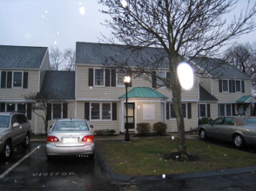
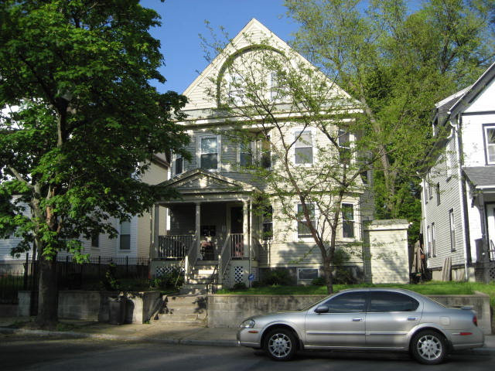
Sample Loans
51 Victoria Heights, Hyde Park 68 Bernard Street #1, Dorchester
 | Pre-SUN | SUN | Pre-SUN | SUN
Mortgage Amount | $350,000 | $161,930 | $326,000 | $117,500
Rate | 11.25% | 6.50% | 11.50% | 6.50%
Monthly Payment | $2,522 | $1,545 | $3,561 | $1,063
NSP Purchase Price |  | $123,559 |  | $94,000
Resale Price |  | $154,408 |  | $121,500
Cash from Borrower |  | $6,232 |  | $5,540
Reserves* |  | $3,130 |  | $3,000
* Reserve amounts vary based on property type and annual taxes.

Slide 12
SUN Objectives
Raise $50 MM in debt capital for Boston and Revere
Scale up to $3 MM in mortgages/ month
After approximately 1 year, recapitalize, and redeploy dollars to refinance more loans
Sell seasoned income streams –while retaining mortgage servicing responsibilities
Serve a total of 2,200 families by May of 2015
No more than 15% of loans are delinquent or in default

Slide 13
Progress to Date (September 2010)
# of Families assisted:
Closed or scheduled for closing: 79 units of foreclosed housing
Offers pending: 25 units
Active in last 30 days: 54 units
Raised $3.5 million in first loss reserves
Secured over $32 million of debt finance (closed or committed) at a 4.25% annual interest rate, payable as of May 30, 2015
Working to raise an additional $18 million of debt finance on the same terms
Created a 25% portfolio-level loan loss reserve against future losses and market declines
Developed key relationships with community groups, legal aid organizations, public agencies, REO departments and lenders who serve as referral sources
Developed and implemented underwriting and reporting systems; hired staff/consultants

Slide 14
Fundraising to date
Closed or in progress:
Strategic Grant Partners
The Boston Foundation
Calvert Foundation Social Investment Fund
Kresge Foundation
Clients of Loring, Wolcott & Coolidge
Clients of Reynders McVeigh
Clients of Ballentine Partners
Clients of Veris Wealth Partners
Jewish Funds for Justice
Individual investors

Slide 15
How You Can Help
5 year loans to help meet the $50M need -- No minimum investment
Interest rate at or below 4.25%
Payable in full May 30, 2015
Funds to be drawn, as needed, to avoid negative arbitrage
Interest payable quarterly
Contributing interest payment to BCC leverages additional dollars on a roughly 2-1 basis
Two investment options:
Individual loans
Program Related Investments from foundations
Debt rather than grant leverages philanthropic dollars
Counts toward 5% payout requirement in year disbursement is made
Added back to 5% payout requirement for year in which repayment is made
If funds are lost, they are subtracted from annual required disbursement
Tax analysis has been accomplished; Loan to SUN qualifies for PRI treatment; draft legal opinion in hand

